Slide 1
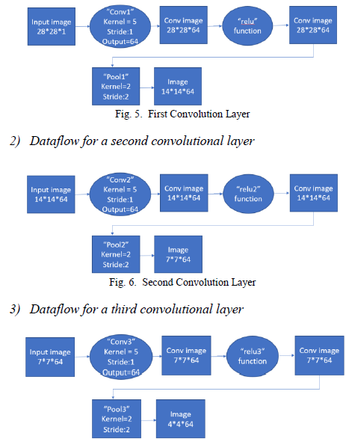
Architecture used in the paper
The architecture used in the paper is to build 3 Convolutional layers each with a different dataflow
then the result sent to the non-linear activation function (relu)
pooling layers in between the conv. Layers to reduce the dimension of the matrix and increase the efficiency of the feature extraction.
Then to the fully-connected layer to combine all the features detected from the input image.
then the whole matrix was flattening and gives the output in one of the classes.

Slide 2
Dataset details
The dataset chosen for our project was Mnist_corrupted.
MNISTCorrupted is a dataset generated by adding 15 corruptions to the test images in the MNIST dataset. This dataset wraps the static, corrupted MNIST test images uploaded by the original authors.
It contains 10,000 test images and 60,000 training images.
It contains 10 classes.
Images dimensions is 28x28x1.

Slide 3
Implementation details
We started off by preprocessing the dataset and reshaping the images making them greyscale, converting them to type ‘float 32’ and dividing each by 255 to normalize the dataset.
Then we built the CNN model just as the paper with the same dataflow : 3 Conv. Layers with average pooling layers in between them and after the last conv layer, Flatten the matrix, and one fully connected layer before the output layer.
Finally we compiled the model with adam optimizer and used losses. SparseCategoricalCrossentropy() to calculate the loss and fit the model with validation split equals to 0.2, epochs = 5 and batch size = 32.

Slide 4
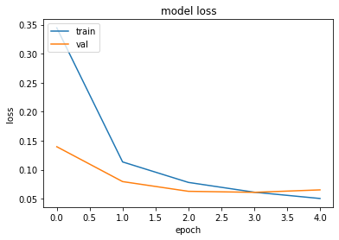
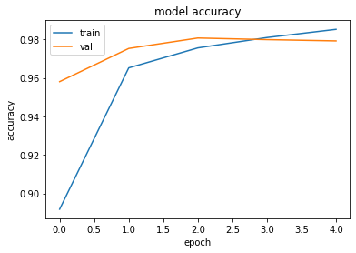
Results and visualizations
We were able to get an accuracy of 0.98 and loss of 0.05 on our training set
accuracy of the model in the test phase was: 0.98 and loss of: 0.03

